Slide 1

The Emergence of Ethnocentrism in Prisoner’s Dilemma
(And other types)
A Complexity Science Course Project
github.com/Beckinetic/ethnocentrism
Afon Khari, Xaver Weidinger, Yifan Luo
October 21st, 2024

Slide 2
Ethnocentrism
Merriam-Webster. (n.d.). Ethnocentrism. In Merriam-Webster.com dictionary. Retrieved October 21, 2024, from https://www.merriam-webster.com/dictionary/ethnocentrism
“The attitude that one's own group, ethnicity, or nationality is superior to others”
Extended definition in our research: Ethnocentrism is the tendency to cooperate (“C”) with in-group agents, and to betray out-group agents (“to defect”, “D”) in PD-game (Prisoner’s Dilemma-game)
The other Prisoner
To In-groups | To Out-groups | Your Type
Co-op | Co-op | Altruist
Co-op | Defect | Ethnocentrist
Defect | Co-op | Cosmopolitan
Defect | Defect | Egoist
 | Co-op | Defect
Co-op | 1 | -γ
Defect | 1+γ | 0
Lacking experience of interacting with either in-groups or out-groups: Undefined
You
γ (gamma) is also called “cooperation barrier”

Slide 3

Network Agent-based Model
With network ABM, we want to simulate
PD-game interaction based on social network structure
Group-membership induced social barriers
Co-evolution of PD-game strategies and network structure
Emergence of different types of agents

Slide 4
Lemos, C.M., Gore, R.J., Lessard-Phillips, L. et al. A network agent-based model of ethnocentrism and intergroup cooperation. Qual Quant 54, 463–489 (2020). https://doi.org/10.1007/s11135-019-00856-y
i
Agent i
Link ij
Group Membership
(major- / minority)
Likeness*
[to-in-group, to-out-group]
Strategies†
[to-in-group, to-out-group]
Communality‡
(numeric)
Type
(Altruist/Ethnocentrist/Cosmopolitan/Egoist)
Interaction History
Always cooperate
Always defect
We added new ones!
1. Play game? 🎮
p = min(likeness_{ij}, likeness_{ji})
Group Membership
2. PD Game 🎲
Cooperate or Defect?
1. Select strategy
2. Consider history
3. Choose action
j
Yay!
Likeness
Payoff for Agent i
💶
Agent j
Strategies
Communality
Action record
Payoff for Agent j
💵
Type
History
Max 100 rounds
Model Part 1: The agent and link properties and the PD game
*Likeness is shared by group members †Strategies are randomly initialised according to likeness ‡Communality is initialised as 0

Slide 5
2. Find neighbor Agent j that
1. Had PD game last round
and
2. Has the most neighbors
Copy strategies?
p = (1 + exp(β⋅(C_{i} - C_{j})))⁻¹
Strategies copied!
Strategic Revision
1. Revise Strategy or Structure?
p_{structure} = W / 20
p_{strategy} = 1 - W / 20
C denotes communality; β = .002
Layman’s interpretation: Copy the strategies of high-communality agents, cut the link with the low-communality agents.
i
Agent i
W ∈ [0, 20]
W is also called structural adaptivity
Structural Revision
2. Select random neighbor Agent j*, see if it
1. betrayed me in the last round
or
2. did not have game last round
Cut link?
p = (1 + exp(β⋅(C_{j} - C_{i})))⁻¹
Cut link_{ij} and create a new link with Agent j’s random neighbor Agent k
Model Part 2: Strategic or Structural Revision After the PD Game
*Agent j must have more than 1 link to avoid itself disconnecting from the network
Notes:
High W -> structural revision

Slide 6

Global parameters
γ (PD-game cooperation barrier)
W (structural adaptivity)
Properties of agents
Likeness
Things to observe
Strategies
Network Structure
Communality
Agent types
History
Max 100 rounds
In-groups | Out-groups
≥ 50% Co-op | ≥ 50% Co-op | Altruist
≥ 50% Co-op | ≥ 50% Defect | Ethnocentrist
≥ 50% Defect | ≥ 50% Co-op | Cosmopolitan
≥ 50% Defect | ≥ 50% Defect | Egoist
Lacking experience of interacting with either in-groups or out-groups: Undefined
Sample Simulation

Slide 7
Experiment 1: Base Model (adapted from Lemos et al., 2020)
Lemos, C.M., Gore, R.J., Lessard-Phillips, L. et al. A network agent-based model of ethnocentrism and intergroup cooperation. Qual Quant 54, 463–489 (2020). https://doi.org/10.1007/s11135-019-00856-y
Research Question: How does γ and W influence the pattern of dominant agent types?
γ: [0 1 2 4 7 10 13 16 18 19 20]
W: [0 1 2 4 7 10 13 16 18 19 20]
In-group Likeness: 0.7
Out-group Likeness: 0.3
Possible Strategies: [Always Cooperate, Always Defect] (Binary Strategies)
Number of Agents: 100 (80 majority, 20 minority)
Small World Network
Link Number: 2
Rewire Probability: 0.2
Simulation Length: 500 Ticks. All metrics acquired in the last tick.
Repetitions: 20

Slide 8
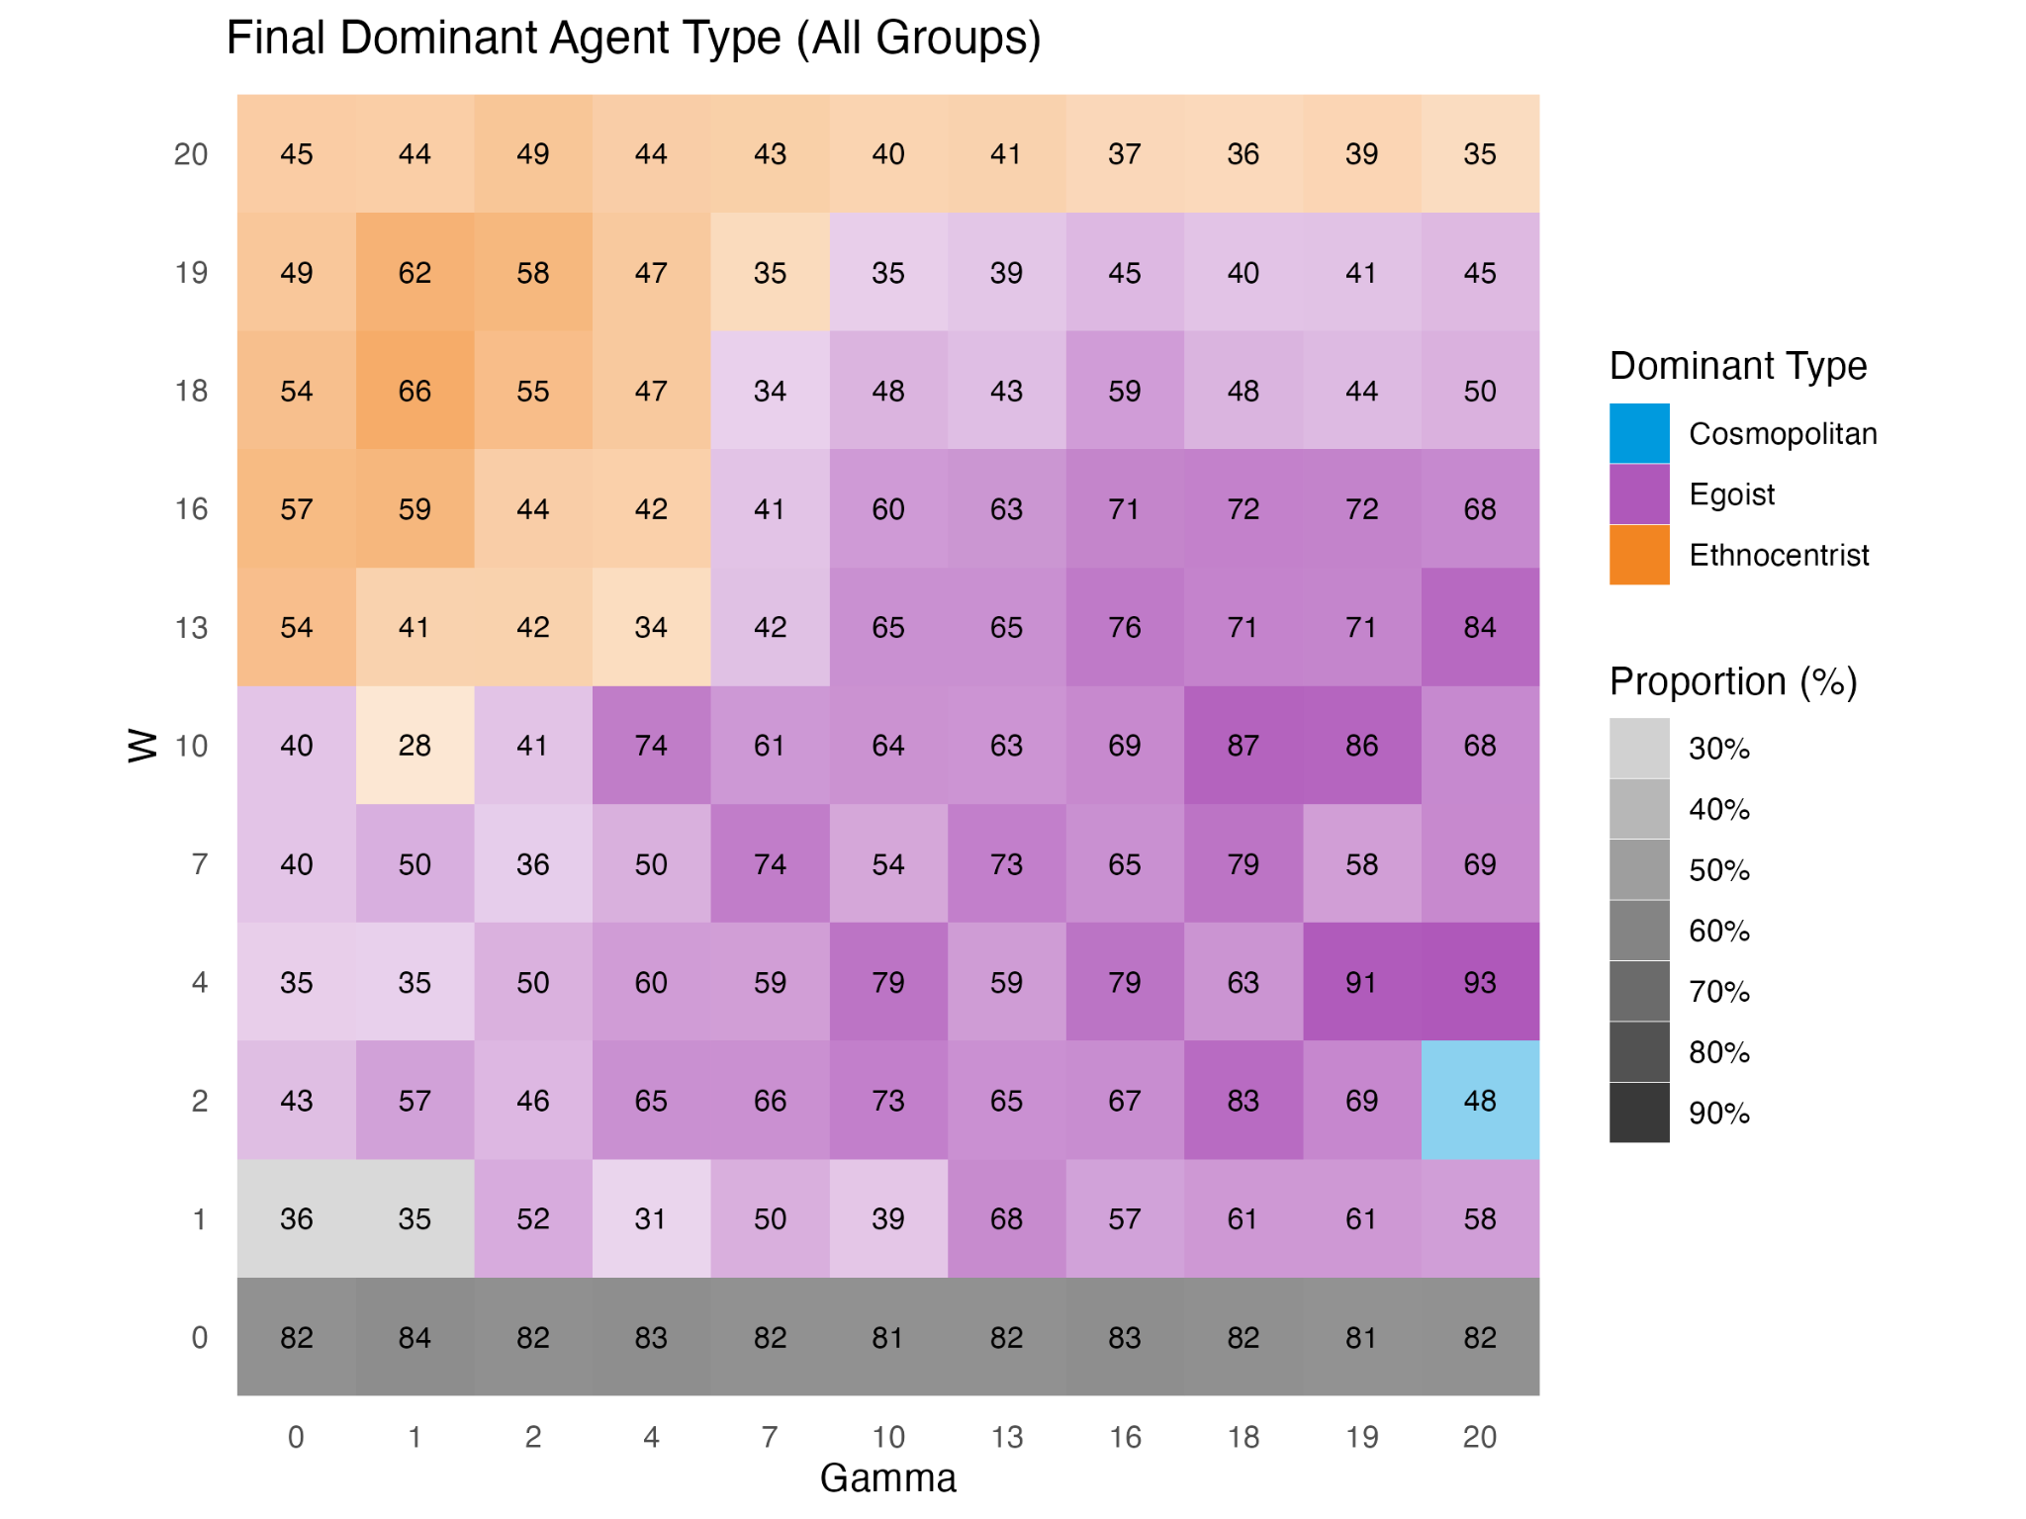
Result
Key Takeaway:
Increasing γ induces defection, leading to the emergence of egoist dominance
Increasing W to a threshold (10~15) would promote the spread of the dominant type (structural > strategic change)
However, when W exceeds the limit, the strategic revision is unlikely to happen, slowing down the propagation of the dominant type.

Slide 9
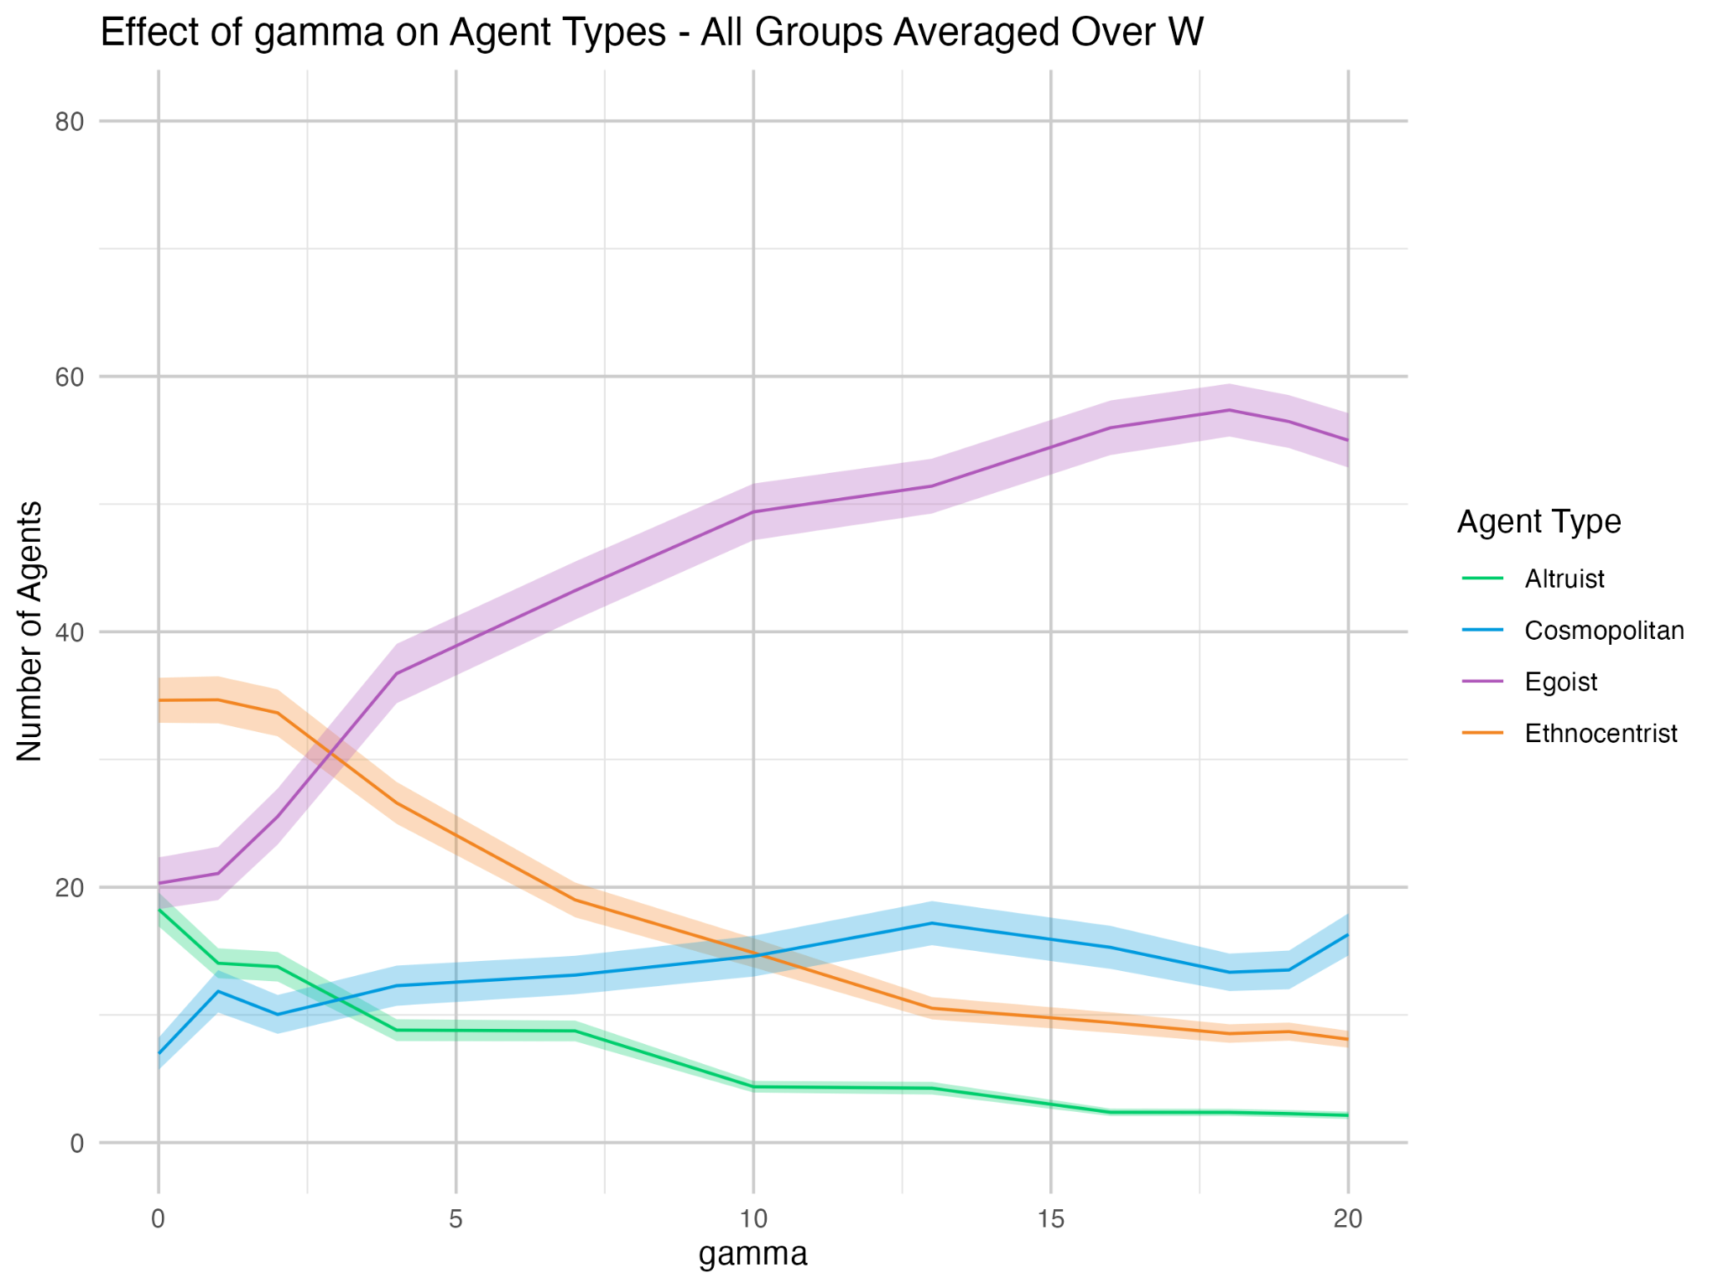
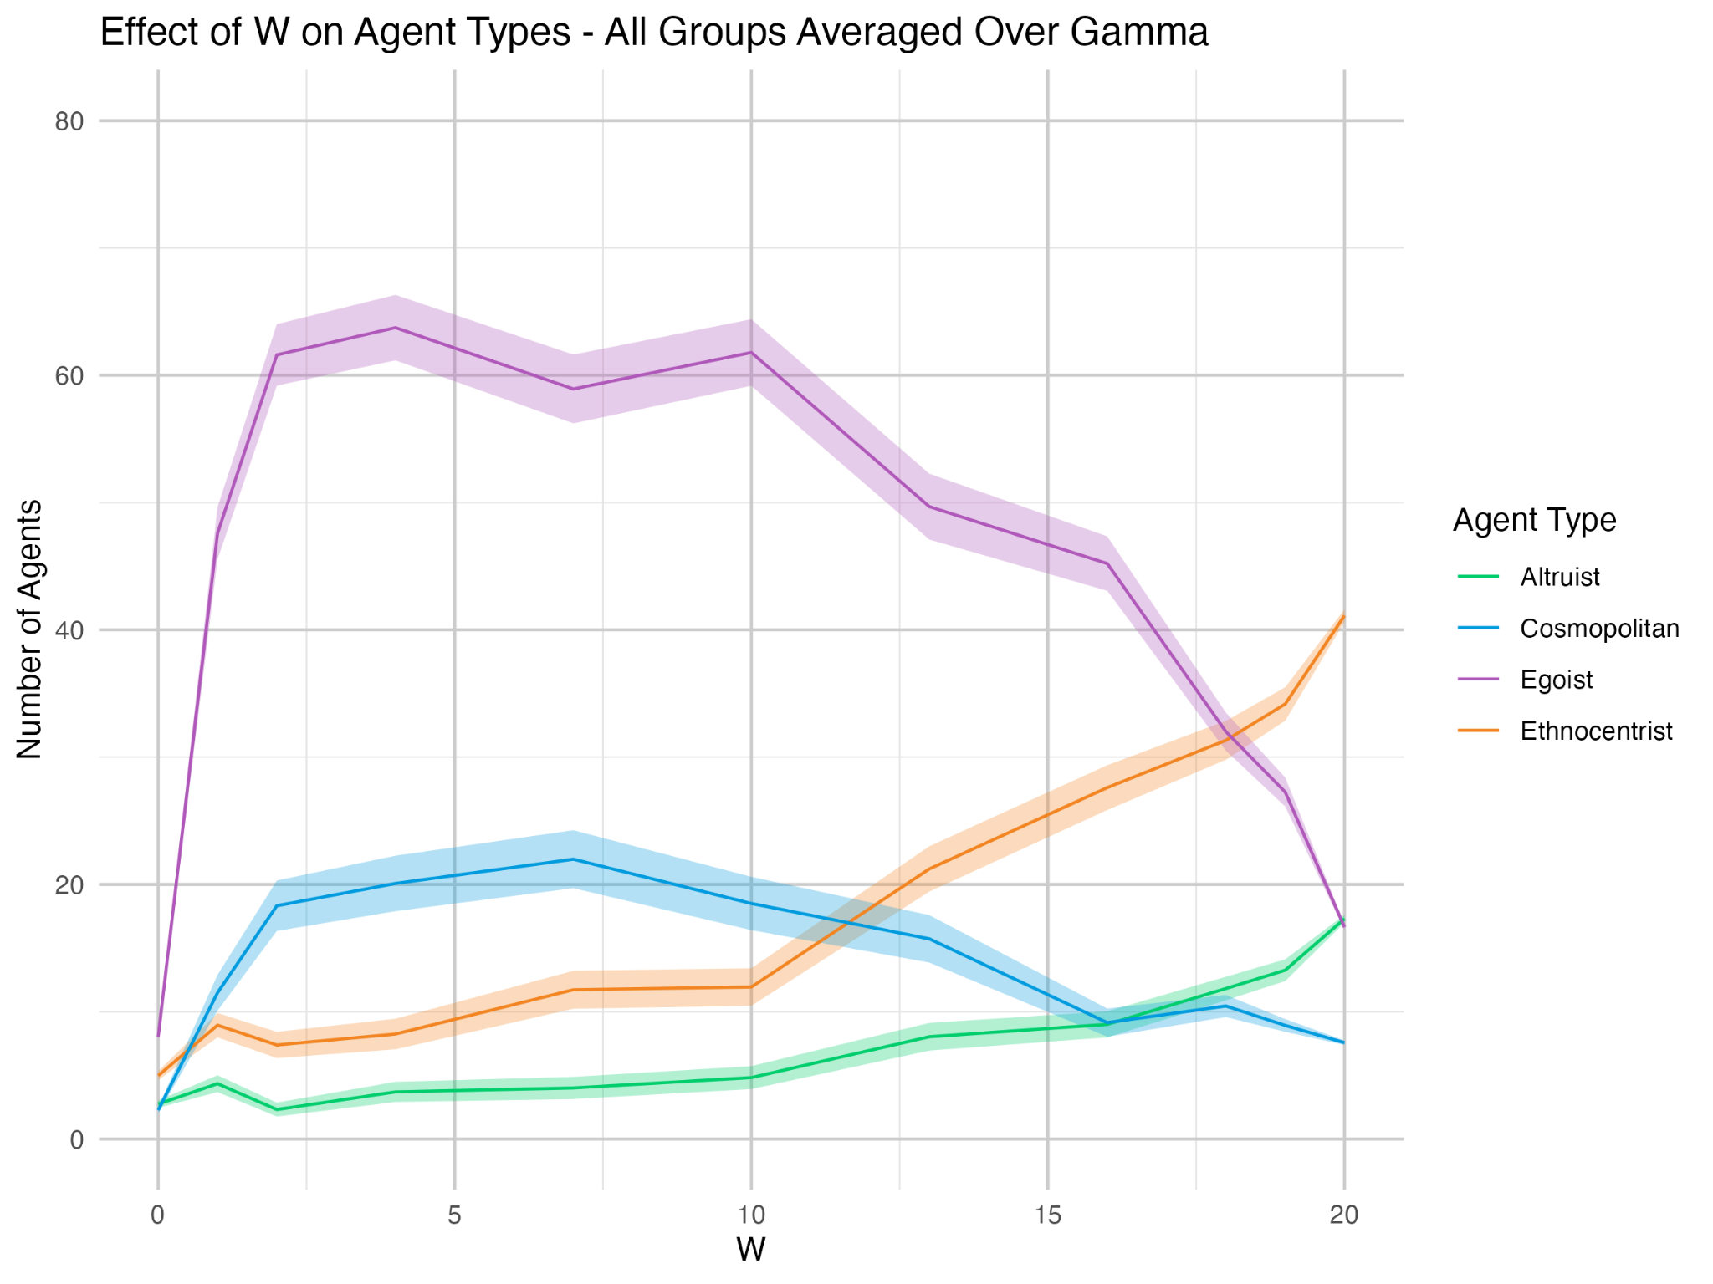
Result
Notes:
0 1 2 4 7 10 13 16 18 19 20 distributions, likeness 70/30

Slide 10
Experiment 2: Perturbation
Research Question: How does structural perturbation change the pattern of γ and W influence?
γ: [0 1 2 4 7 10 13 16 18 19 20]
W: [0 1 2 4 7 10 13 16 18 19 20]
In-group Likeness: 0.7
Out-group Likeness: 0.3
Possible Strategies: [Always Cooperate, Always Defect]
Perturbation
Every 35 ticks, add a random new link for every agent*
*If it is not already connected to every other one
Number of Agents: 100 (80 majority, 20 minority)
Small World Network
Link Number: 2
Rewire Probability: 0.2
Simulation Length: 500 Ticks. All metrics acquired in the last tick.
Repetitions: 20

Slide 11
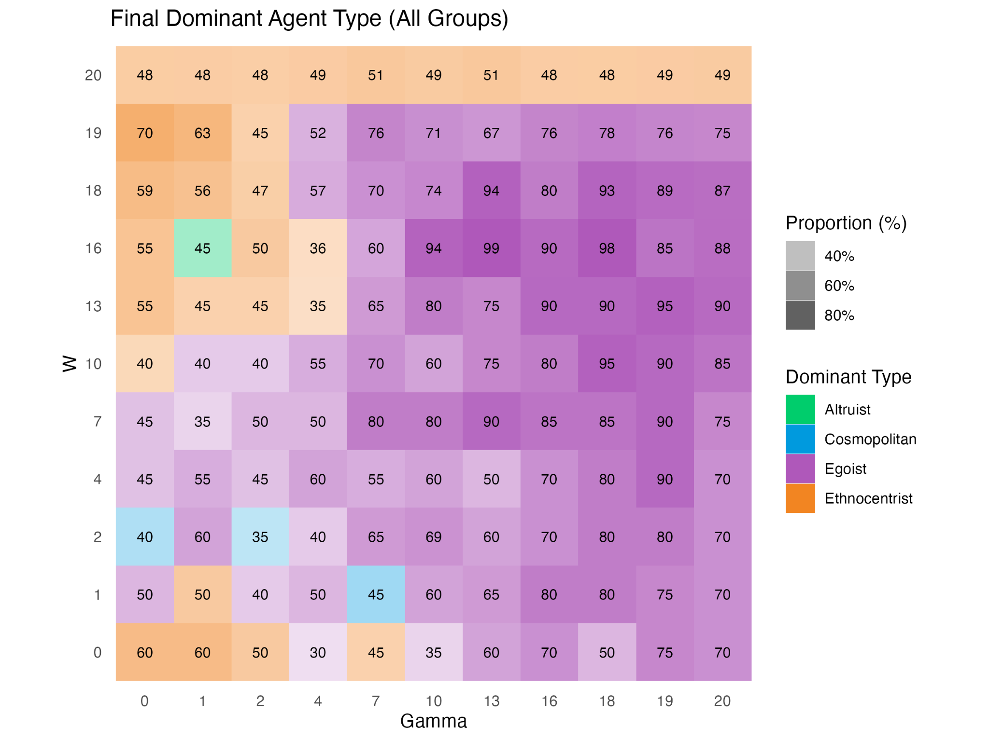
Result
Key Takeaway:
The whole landscape does not display much change
Slight increase in most dominant (egoistic) type

Slide 12
Perturbation No Perturbation

Slide 13
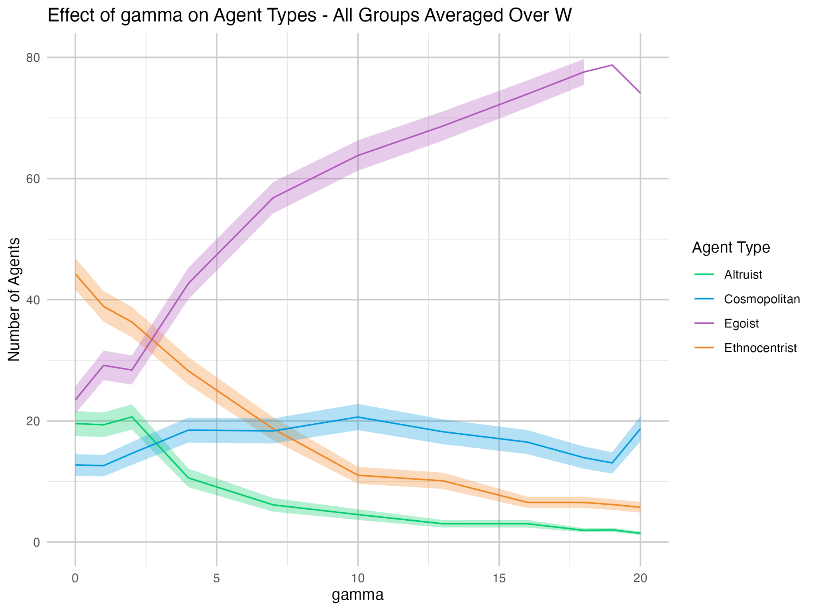
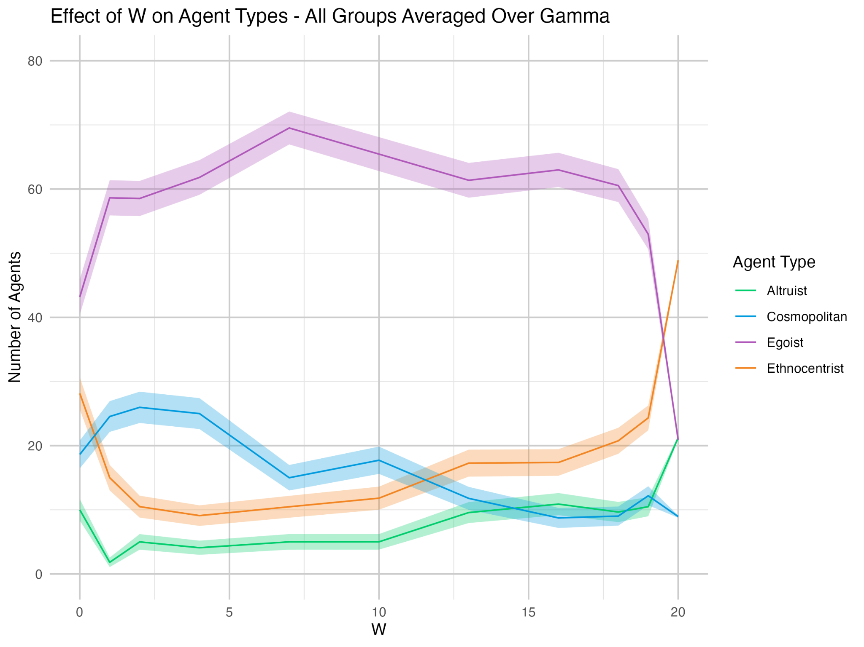
Result

Slide 14
Experiment 3: Adding Other Common Strategies (Bó et al., 2019)
Dal Bó, Pedro, and Guillaume R. Fréchette. 2019. "Strategy Choice in the Infinitely Repeated Prisoner's Dilemma." American Economic Review, 109 (11): 3929–52.
Research Question: How does new strategies change the pattern of γ and W influence?
γ: [0 1 2 4 7 10 13 16 18 19 20]
W: [0 1 2 4 7 10 13 16 18 19 20]
In-group Likeness: 0.7
Out-group Likeness: 0.3
Possible Strategies: [Always Cooperate, Tit-for-two-tats, Tit-for-tat, Grim Trigger, Always Defect]
“Betrayed twice,
then betray.”
“Do the same as you did last round”
“Betrayed once, never co-op”
Number of Agents: 100 (80 majority, 20 minority)
Small World Network
Link Number: 2
Rewire Probability: 0.2
Simulation Length: 500 Ticks. All metrics acquired in the last tick.
Repetitions: 20

Slide 15
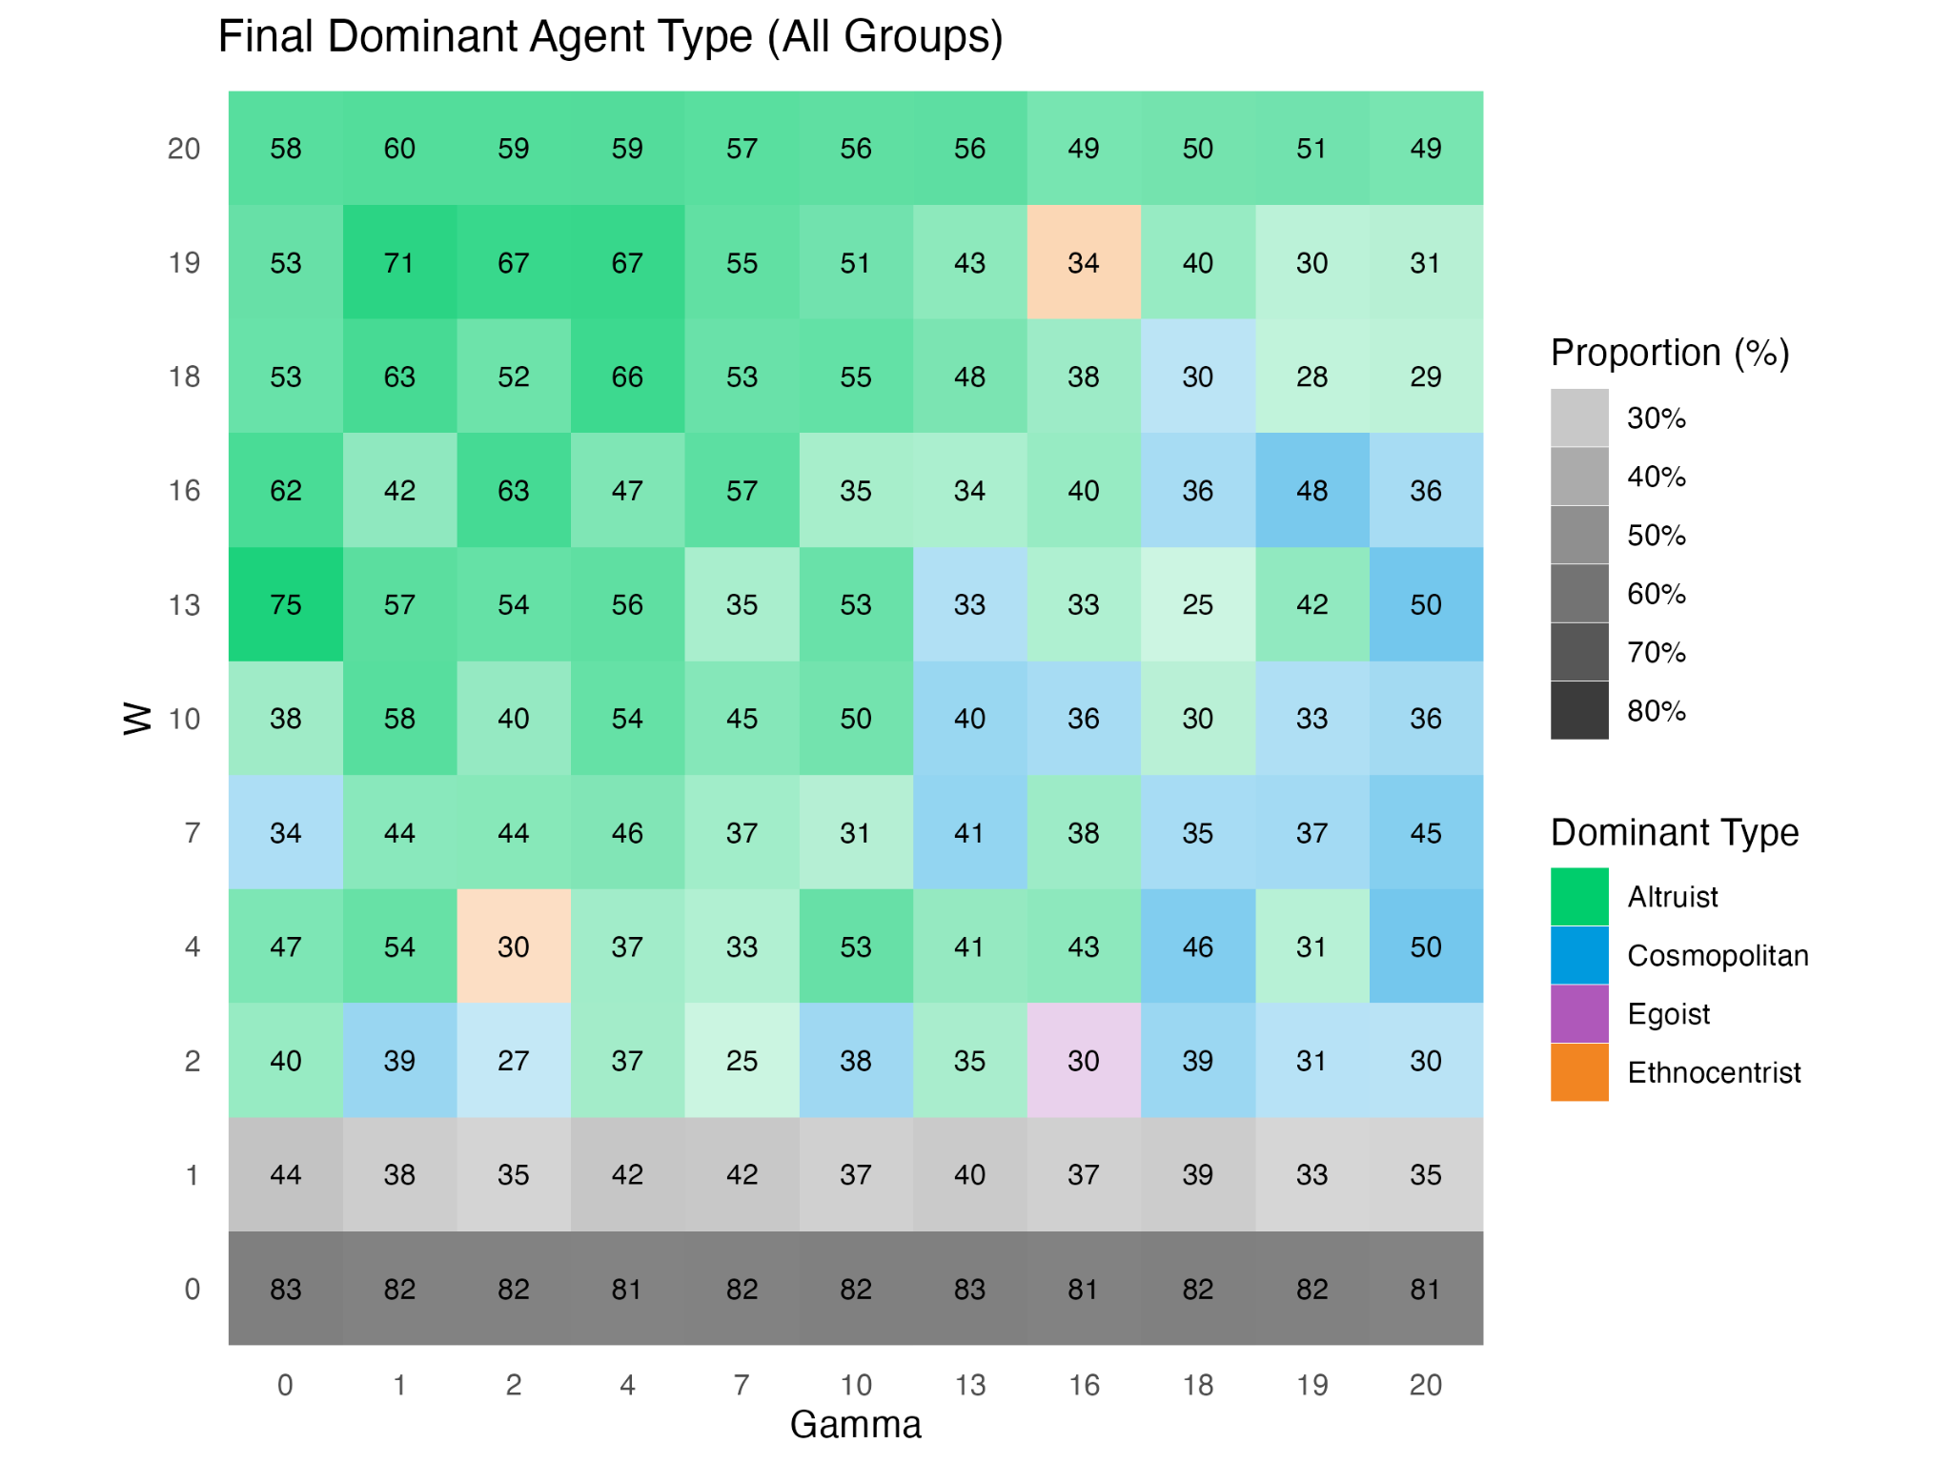
Result
Key Takeaway:
Adding new strategies causes an overall increase in altruism and cosmopolitanism across different γ and W values.
Increasing γ still induces defection and W shows similar pattern as in the base model

Slide 16
Adding new Strategies Binary Strategies

Slide 17
Experiment 4: Base Model (adapted from Lemos et al., 2020)
Lemos, C.M., Gore, R.J., Lessard-Phillips, L. et al. A network agent-based model of ethnocentrism and intergroup cooperation. Qual Quant 54, 463–489 (2020). https://doi.org/10.1007/s11135-019-00856-y
Research Question: How does likeness influence the pattern of dominant agent types?
γ and W: [5, 10], [5, 19]
In-group Likeness: 0.1~0.9 (Stepsize: 0.1)
Out-group Likeness: 0.1~0.9 (Stepsize: 0.1)
Possible Strategies: [Always Cooperate, Always Defect] (Binary Strategies)
Number of Agents: 100 (80 majority, 20 minority)
Small World Network
Link Number: 2
Rewire Probability: 0.2
Simulation Length: 500 Ticks. All metrics acquired in the last tick.
Repetitions: 20

Slide 18
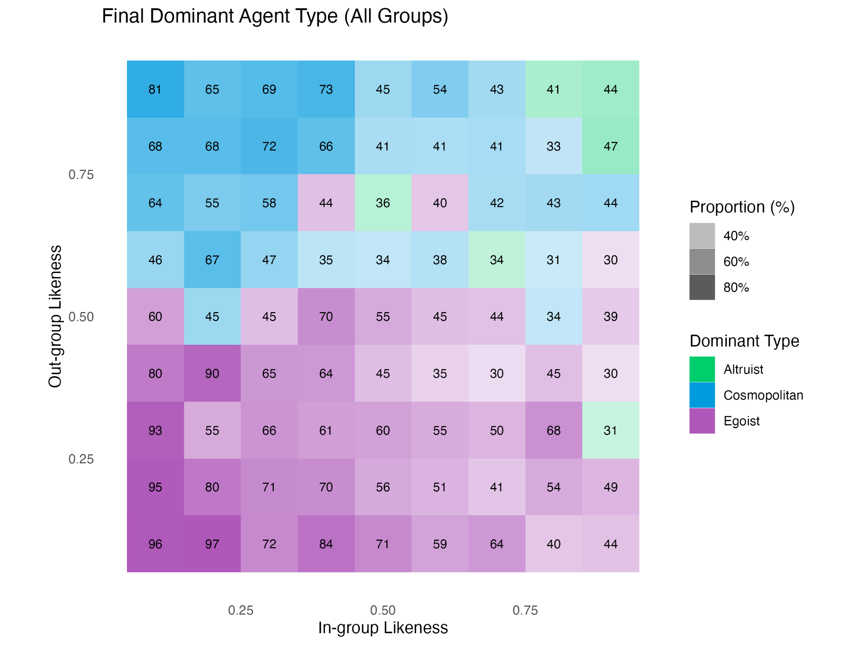
Result (γ = 5, W = 10)
Key Takeaway:
High out-group likeness promotes cosmopolitanism; low out-group likeness promotes egoism
High in-group and also out-group likeness (might) promote altruism

Slide 19
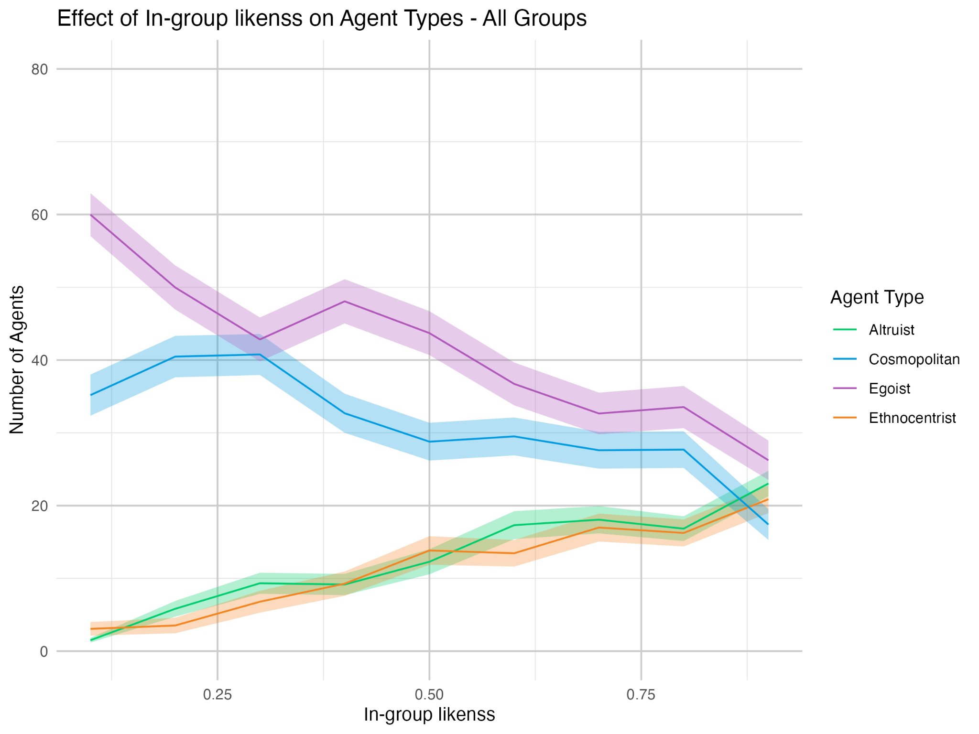
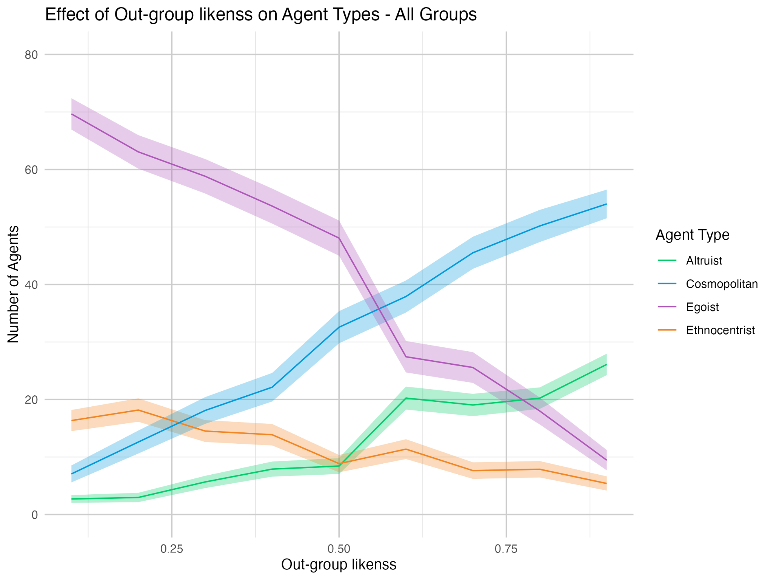
Result (γ = 5, W = 10)

Slide 20
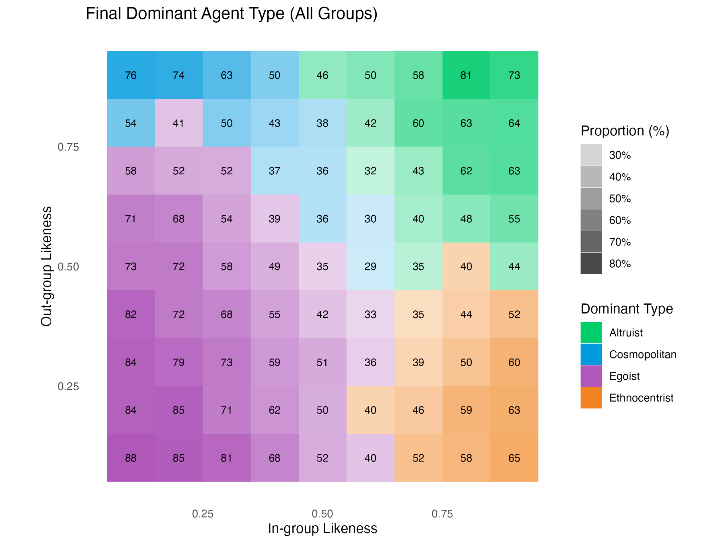
Result (γ = 5, W = 19)
Key Takeaway:
In extra adaptive structure, ethnocentrism and altruism emerge

Slide 21
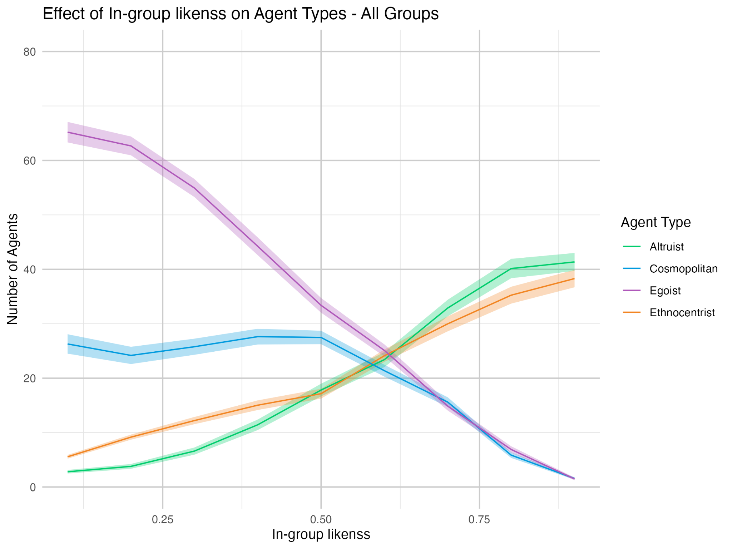
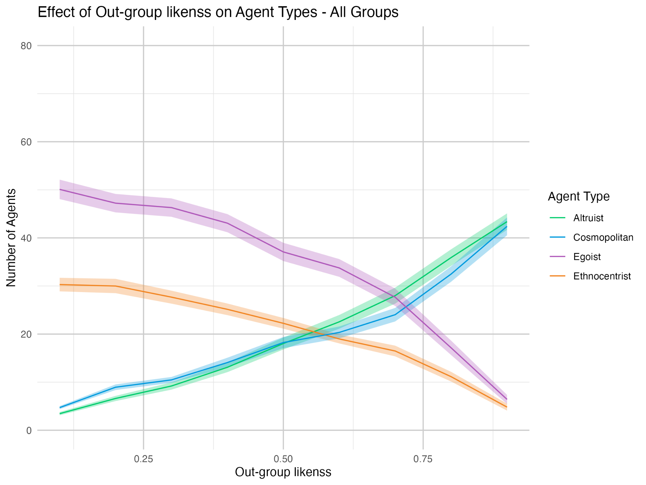
Result (γ = 5, W = 19)

Slide 22
General Remarks
Key parameters and modifications 🔧
High cooperation barrier promotes defect
Adaptive structure propagates the dominant type
Adding new strategies lead to altruism surge: “Don’t be evil”
Limited effect from perturbation
Emergence of types 🟦🟥🟧🟪
Ethnocentrism emerges in low cooperation barrier, highly adaptive structure, and favourable likeness condition
Egoism prevalence implies different innate ability to spread across types

Slide 23
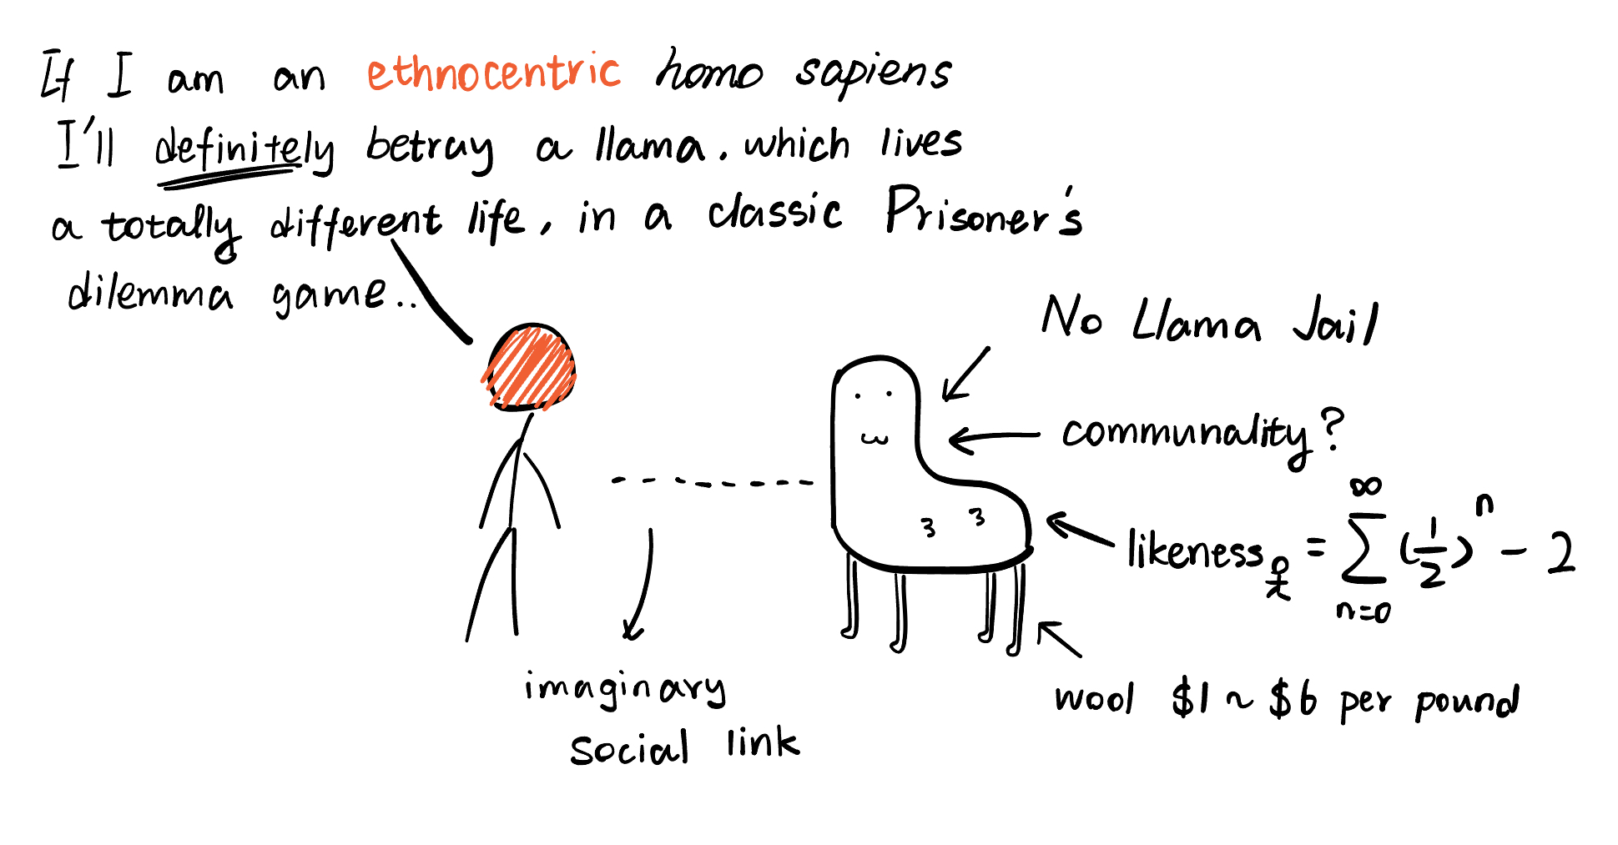
Thanks!
Afon Khari, Xaver Weidinger, Yifan Luo
Data and code are available here!
github.com/Beckinetic/ethnocentrism

